Slide 1
INA047 - PPT - SESI 3 METODOLOGI PENELITIAN
Syam Gunawan

Slide 2
Course Outline
1. Pengantar Penelitian
2. Tahapan Penelitian
3. Literature Review
4. Penulisan Ilmiah dan Publikasi Penelitian
5. Systematic Literature Review (SLR)
6. Pembimbingan dan Presentasi Penelitian

Slide 3
2. Tahapan Penelitian
2.1 Tahapan Penelitian Umum
2.2 Tahapan Penelitian Computing
2.3 Tahapan Penelitian Computing Fokus Perbaikan Algoritma

Slide 4
2.1 Tahapan Penelitian Umum

Slide 5
Tahapan Penelitian Umum
1. Identifikasi Masalah
2. Perumusan Hipotesis
3. Pengujian Hipotesis dan Analisis
4. Kesimpulan

Slide 6
Tahapan Penelitian Umum vs Tesis
Tahapan Penelitian | Susunan Tesis
1. Identifikasi Masalah | 1. Pendahuluan: - Latar Belakang - Rumusan Masalah - Tujuan Penelitian - Manfaat Penelitian
2. Perumusan Hipotesis | 2. Landasan Teori: - Penelitian yang Berhubungan - Landasan Teori - Kerangka Pemikiran
3. Pengujian Hipotesis dan Analisis Hasil | 3. Metodologi Penelitian: - Metode Penelitian - Metode Pengumpulan Data - Metode Analisis Data - Metode Pengukuran Penelitian
 | 4. Analisis Hasil dan Pembahasan
4. Kesimpulan | 5. Kesimpulan dan Saran

Slide 7
2.2 Tahapan Penelitian Computing

Slide 8
Tahapan Penelitian Computing
1. Penentuan Bidang Penelitian (Research Field)
2. Penentuan Topik Penelitian (Research Topic)
3. Penentuan Masalah Penelitian (Research Problem)
4. Perangkuman Metode-Metode Yang Ada (State-of-the-Art Methods)
5. Penentuan Metode Yang Diusulkan (Proposed Method)
6. Evaluasi Metode Yang Diusulkan (Evaluation)
7. Penulisan Ilmiah dan Publikasi Hasil Penelitian (Publications)
*https://www.site.uottawa.ca/~bochmann/dsrg/how-to-do-good-research/
*http://romisatriawahono.net/2013/01/23/tahapan-memulai-penelitian-untuk-mahasiswa-galau/

Slide 9
1. Penentuan Bidang Penelitian
Ingat kembali seluruh mata kuliah yang sudah kita terima di perkuliahan
Bidang penelitian di disiplin computing:
Tentukan berdasarkan passion!
Contoh: Saya memilih bidang Software Engineering (SE)
Software Engineering | Data Mining
Image Processing | Computer Vision
Networking | Human Computer Interaction
Soft Computing | Information Retrieval
Bioinformatics | dsb

Slide 10
2. Penentuan Topik Penelitian
Searching di google, google scholar, ACM, IEEE Explore, ScienceDirect.Com:
research trends challenge topics on NAMA BIDANG
Contoh:
Dari paper-paper survey dan review tentang software engineering, saya tahu trend penelitian di bidang SE:
Autonomic Computing or Self Adaptive Software
Software Effort/Cost Estimation
Software Defect Prediction
Software Process Improvement
Service Oriented Architecture
Soft Computing Applications in Software Testing, Design, Requirement Engineering, Product Lines, etc
Saya mengambil topik penelitian: Software Defect Prediction

Slide 11
Software Engineering Research Trends
* Resources: - Survey Papers from ScienceDirect, SpringerLink, and IEEE Explore
- Publication Year: 2011-2014

Slide 12
Data Mining
Estimasi (Estimation)
Neural Network, Multiple Linear Regression, dsb
Prediksi (Prediction):
Neural Network, Multiple Linear Regression, SVM, dsb
Klasifikasi (Classification):
CART, K-NN, ID3, C4.5, dsb
Pengelompokan (Clustering):
K-Means, Fuzzy C-Means, SOM, K-Medoids, dsb
Asosiasi (Association):
Apriori, FP-Growth, dsb

Slide 13
Image Processing
Image Restoration
Image Compression
Biometrics:
Face/Fingerprint/Iris Identification
Real Application:
Car Plate Identification
Vehicle Motion Detection

Slide 14
Kumpulan Survey Paper di Berbagai Bidang Penelitian Computing
Baca artikel tentang tahapan memulai penelitian untuk mahasiswa galau di romisatriawahono.net
Tentukan topic penelitian yang kira-kira kita inginkan lewat paper-paper di: http://romisatriawahono.net/lecture/rm/survey/
Baca paper survey dan rangkumkan dalam bentuk slide

Slide 15
3. Penentuan Masalah Penelitian
Searching di google, google scholar, ScienceDirect.Com:
Survey review on NAMA TOPIK
Research problem challenge on NAMA TOPIK
Dari “survey paper” yang ditemukan, kejar sampai dapat semua “technical paper” yang ada di daftar referensinya
Dari puluhan/ratusan/ribuan paper yang didapat lakukan scanning, pilih paper journal yang terindeks SCOPUS/ISI, 3 tahun terakhir, dan peta kan masalah penelitian yang ada di paper-paper itu
Gunakan Mendeley untuk mempermudah pekerjaan kita
Pilih satu atau dua masalah penelitian yang kita anggap menarik dan menantang, dan jadikan itu masalah penelitian kita

Slide 16
Susun Research Problem dan Landasan
Masalah Penelitian | Landasan Literatur
Data set pada prediksi cacat software berdimensi tinggi, memiliki atribut yang bersifat noisy, dan classnya bersifat tidak seimbang, menyebabkan penurunan akurasi pada prediksi cacat software | There are noisy data points in the software defect data sets that can not be confidently assumed to be erroneous using such simple method (Gray, Bowes, Davey, & Christianson, 2011)
 | The performances of software defect prediction improved when irrelevant and redundant attributes are removed (Wang, Khoshgoftaar, & Napolitano, 2010)
 | The software defect prediction performance decreases significantly because the dataset contains noisy attributes (Kim, Zhang, Wu, & Gong, 2011)
 | Software defect datasets have an imbalanced nature with very few defective modules compared to defect-free ones (Tosun, Bener, Turhan, & Menzies, 2010)
 | Imbalance can lead to a model that is not practical in software defect prediction, because most instances will be predicted as non-defect prone (Khoshgoftaar, Van Hulse, & Napolitano, 2011)
 | Software fault prediction data sets are often highly imbalanced (Zhang & Zhang, 2007)

Slide 17
4. Perangkuman Metode Yang Ada
Pahami semua paper penelitian yang tujuannya memecahkan masalah yang sama dengan yang kita pilih
Pahami metode/algoritma terkini yang mereka gunakan untuk memecahkan masalah penelitian mereka. Ini yang disebut dengan state-of-the-art method
Dalam bidang computing, metode biasanya berupa algoritma yang secara sistematis, logis dan matematis menyelesaikan masalah

Slide 18
The State-of-the-Art Method
The highest level of development, as of a device, technique, or scientific field, achieved at a particular time
The level of development (as of a device, procedure, process, technique, or science) reached at any particular time usually as a result of modern methods (Merriam Webster Dictionary)
This machine is an example of state-of-the-art technology
The state of the art in this field is mostly related to the ABC technology
A concept used in the process of assessing and asserting novelty and inventive step (European Patent Convention (EPC))

Slide 19
State-of-the-Art Frameworks in Software Defect Prediction
Menzies Framework
(Menzies et al. 2007)
Lessmann Framework
(Lessmann et al. 2008)
Song Framework
(Song et al. 2011)
Notes:
This is the answer of RQ9 of this SLR
Recently, there are three frameworks that have been highly cited and therefore influential in software defect prediction field:
Menzies et al. Framework (Menzies et al. 2007)
Lessmann et al. Framework (Lessmann et al. 2008)
Song et al. Framework (Song et al. 2011).

Slide 20
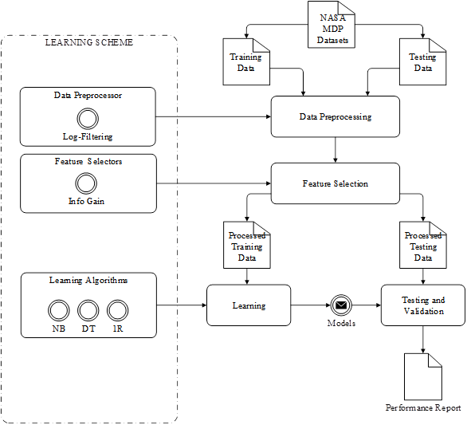
Menzies Framework (Menzies et al. 2007)
Framework | Dataset | Data Preprocessor | Feature Selectors | Meta-learning | Classifiers | Parameter Selectors | Validation Methods | Evaluation Methods
(Menzies et al. 2007) | NASA MDP | Log Filtering | Info Gain | - | 3 algorithms (DT, 1R, NB) | - | 10-Fold X Validation | ROC Curve (AUC)

Slide 21
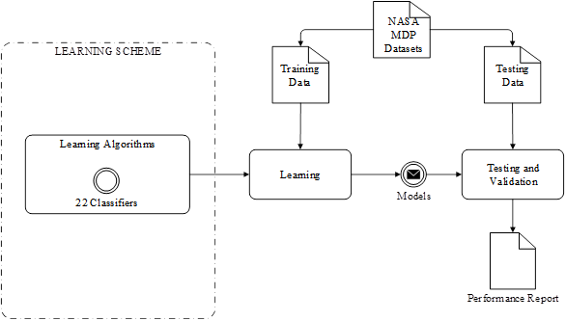
Lessmann Framework (Lessmann et al. 2008)
Framework | Dataset | Data Preprocessor | Feature Selectors | Meta-learning | Classifiers | Parameter Selectors | Validation Methods | Evaluation Methods
(Lessman et al. 2008) | NASA MDP | - | - | - | 22 algorithms | - | 10-Fold X Validation | ROC Curve (AUC)

Slide 22

Song Framework (Song et al. 2011)
Framework | Dataset | Data Preprocessor | Feature Selectors | Meta-learning | Classifiers | Parameter Selectors | Validation Methods | Evaluation Methods
(Song et al. 2011) | NASA MDP | Log Filtering | FS, BE | - | 3 algorithms (DT, 1R, NB) | - | 10-Fold X Validation | ROC Curve (AUC)

Slide 23
Proposed Framework
Framework | Dataset | Data Preprocessor | Feature Selectors | Meta-Learning | Classifiers | Parameter Selectors | Validation Methods | Evaluation Methods
(Menzies et al. 2007) | NASA MDP | Log Filtering | Info Gain |  | 3 algorithm (DT, 1R, NB) | - | 10-Fold X Validation | ROC Curve (AUC)
(Lessman et al. 2008) | NASA MDP | - | - |  | 22 algorithm | - | 10-Fold X Validation | ROC Curve (AUC)
(Song et al. 2011) | NASA MDP | Log Filtering | FS, BE |  | 3 algorithm (DT, 1R, NB) | - | 10-Fold X Validation | ROC Curve (AUC)
Proposed Framework | NASA MDP | - | PSO, GA | Bagging | 10 algorithms | GA | 10-Fold X Validation | ROC Curve (AUC)
Notes:
This is my proposed framework. This slide shows you, what is the different between these frameworks and the proposed framework
In the proposed framework, metaheuristic optimization methods, PSO and GA, have been used as a feature selector and a parameter selector of the classifiers
While considerable work has been done for metaheuristic optimization based feature selection and class imbalance problem separately, but limited research can be found on investigating them both together, particularly in the software engineering field
In this study, metaheuristic optimization based feature selection and bagging technique are combined for solving the class imbalance problem, in the context of software defect prediction.

Slide 24
5. Penentuan Metode Yang Diusulkan
Kita harus membangun dan mengusulkan suatu metode (proposed method), yg lebih baik bila dibandingkan dengan metode-metode yang ada saat ini
Keunggulan metode yang kita usulkan harus dilandasi (reference), dibuktikan secara matematis dan empiris lewat hasil eksperimen dan perbandingan dengan metode yang ada
Metode yang kita usulkan itu bisa saja dari state-of-the-art methods, kita kemudian “menambahkan” sesuatu (algoritma, koefisien, formula, dsb), yang akhirnya ketika kita bandingkan dengan metode original, metode kita lebih baik (lebih cepat, lebih akurat, lebih konsisten, dsb).
“Penambahan” yang kita lakukan dan akhirnya membuat pemecahan masalah menjadi lebih baik itulah yang disebut dengan kontribusi ke pengetahuan (contribution to knowledge) (Dawson, 2009)

Slide 25
Susun RP-RQ-RO
Research Problem (RP) | Research Question (RQ) | Research Objective (RO)
RP1. Data set pada prediksi cacat software berdimensi tinggi, memiliki atribut yang bersifat noisy, dan classnya bersifat tidak seimbang, menyebabkan penurunan akurasi pada prediksi cacat software | RQ1. Algoritma pemilihan fitur apa yang performanya terbaik untuk meyelesaikan masalah atribut yang noisy pada prediksi cacat software? | RO1. Mengidentifikasi algoritma pemilihan fitur apa yang memiliki performa terbaik apabila digunakan untuk menyelesaikan masalah atribut yang noisy pada prediksi cacat software
 | RQ2. Algoritma meta learning apa yang performanya terbaik untuk menyelesaikan masalah class imbalance pada prediksi cacat software? | RO2. Mengidentifikasi algoritma meta learning apa yang memiliki performa terbaik apabila digunakan untuk menyelesaikan masalah class imbalance pada prediksi cacat software
 | RQ3. Bagaimana pengaruh penggabungan algoritma pemilihan fitur dan metode meta learning terbaik pada peningkatan akurasi prediksi cacat software? | RO3. Mengembangkan algoritma baru yang menggabungkan algoritma pemilihan fitur dan meta learning terbaik untuk meningkatkan akurasi pada prediksi cacat software

Slide 26
Proposed Framework
Framework | Dataset | Data Preprocessor | Feature Selectors | Meta-Learning | Classifiers | Parameter Selectors | Validation Methods | Evaluation Methods
(Menzies et al. 2007) | NASA MDP | Log Filtering | Info Gain |  | 3 algorithm (DT, 1R, NB) | - | 10-Fold X Validation | ROC Curve (AUC)
(Lessman et al. 2008) | NASA MDP | - | - |  | 22 algorithm | - | 10-Fold X Validation | ROC Curve (AUC)
(Song et al. 2011) | NASA MDP | Log Filtering | FS, BE |  | 3 algorithm (DT, 1R, NB) | - | 10-Fold X Validation | ROC Curve (AUC)
Proposed Framework | NASA MDP | - | PSO, GA | Bagging | 10 algorithms | GA | 10-Fold X Validation | ROC Curve (AUC)
Notes:
This is my proposed framework. This slide shows you, what is the different between these frameworks and the proposed framework
In the proposed framework, metaheuristic optimization methods, PSO and GA, have been used as a feature selector and a parameter selector of the classifiers
While considerable work has been done for metaheuristic optimization based feature selection and class imbalance problem separately, but limited research can be found on investigating them both together, particularly in the software engineering field
In this study, metaheuristic optimization based feature selection and bagging technique are combined for solving the class imbalance problem, in the context of software defect prediction.

Slide 27
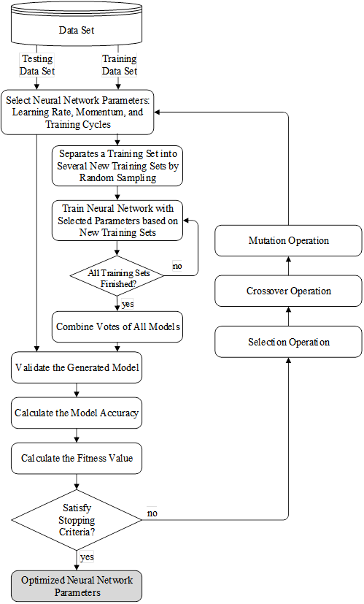
A Hybrid Genetic Algorithm based Neural Network Parameter Optimization and Bagging Technique for Software Defect Prediction (NN GAPO+B)
Every chromosome is evaluated by the fitness function Equation
Where
A: classification accuracy
P_{i}: parameter value
W_{A}: weight of classification accuracy
W_{p}: parameter weight
C_{i}: feature cost
S: setting constant
When ending condition is satisfied, the operation ends and the optimized NN parameters are produced. Otherwise, the process will continue with the next generation operation

Slide 28
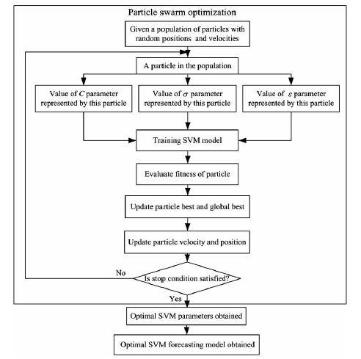
Contoh Proposed Method
Metode yang diusulkan adalah metode SVM dengan pemilihan parameter C, Gamma dan Epsilon diotomatisasi menggunakan PSO

Slide 29
6. Evaluasi Metode Yang Diusulkan
Metode yang diusulkan harus divalidasi dan dievaluasi dengan metode pengukuran standard dan disepakati para peneliti di bidang penelitian yang kita lakukan
Pengukuran metode disesuaikan dengan masalah dan tujuan penelitian:
Masalahnya rendahnya akurasi → pengukurannya akurasi
Masalah rendahnya efisiensi → pengukurannya waktu

Slide 30
Evaluasi pada Penelitian Data Mining
Estimation:
Error: Root Mean Square Error (RMSE), MSE, MAPE, etc
Prediction/Forecasting (Prediksi/Peramalan):
Error: Root Mean Square Error (RMSE) , MSE, MAPE, etc
Classification:
Confusion Matrix: Accuracy
ROC Curve: Area Under Curve (AUC)
Clustering:
Internal Evaluation: Davies–Bouldin index, Dunn index,
External Evaluation: Rand measure, F-measure, Jaccard index, Fowlkes–Mallows index, Confusion matrix
Association:
Lift Charts: Lift Ratio
Precision and Recall (F-measure)

Slide 31
7. Penulisan Ilmiah dan Publikasi Hasil Penelitian
Lakukan pendataan journal-journal yang ada di bidang kita, urutkan berdasarkan rangking SJR atau JIF
Pilih target journal untuk tempat publikasi hasil penelitian kita
Publikasikan hasil penelitian ke journal yang sesuai dengan kualitas kontribusi penelitian yang kita lakukan
A paper is an organized description of hypotheses, data and conclusions, intended to instruct the reader. If your research does not generate papers, it might just as well not have been done (Whitesides 2004)

Slide 32
No | Journal Publications | SJR | Q Category
1 | IEEE Transactions on Software Engineering | 3.39 | Q1 in Software
2 | Information Sciences | 2.96 | Q1 in Information Systems
3 | IEEE Transactions on Systems, Man, and Cybernetics | 2.76 | Q1 in Artificial Intelligence
4 | IEEE Transactions on Knowledge and Data Engineering | 2.68 | Q1 in Information Systems
5 | Empirical Software Engineering | 2.32 | Q1 in Software
6 | Information and Software Technology | 1.95 | Q1 in Information Systems
7 | Automated Software Engineering | 1.78 | Q1 in Software
8 | IEEE Transactions on Reliability | 1.43 | Q1 in Software
9 | Expert Systems with Applications | 1.36 | Q2 in Computer Science
10 | Journal of Systems and Software | 1.09 | Q2 in Software
11 | Software Quality Journal | 0.83 | Q2 in Software
12 | IET Software | 0.55 | Q2 in Software
13 | Advanced Science Letters | 0.24 | Q3 in Computer Science
14 | Journal of Software | 0.23 | Q3 in Software
15 | International Journal of Software Engineering and Its Application | 0.14 | Q4 in Software

Slide 33
RP – RQ – RC dan Publikasi Penelitian

Slide 34
Tugas Menentukan Bidang Penelitian
Analisis kembali berbagai mata kuliah yang telah diajarkan, serta paper dan buku yang telah dibaca
Tentukan bidang dan sub bidang (field dan subfield) penelitian yang kita tertarik untuk melakukannya
Baca artikel tentang tahapan memulai penelitian utk mahasiswa galau di http://romisatriawahono.net

